Slide 1
Hackforge - AI Hackathon
Problem Statement Chosen: 4I APPS - Build your own Chatbot
College: Dr NGP Arts and Science College
Department: Computer Science with Data Analytics
Dhanya K.R, Venkatesh S, Gobika G, Pavithran S
21/03/2025
Team Name: Gen Quests

Slide 2
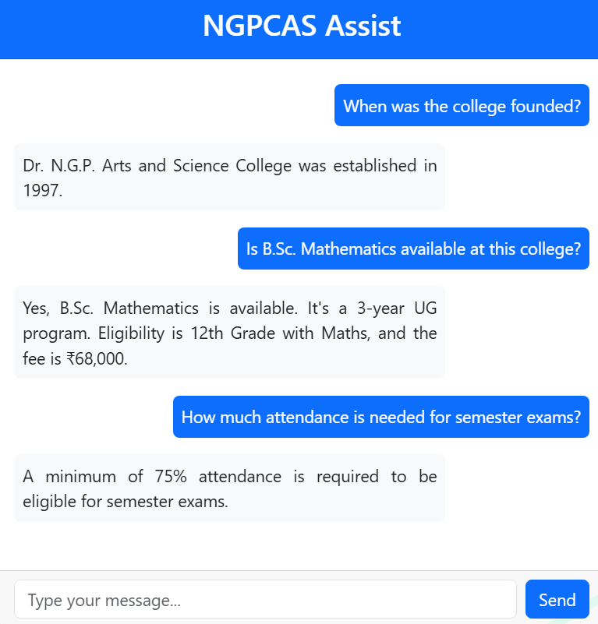
Introduction: The Challenge
Our project addresses a challenge for 4i Apps by building a smart AI chatbot using Retrieval-Augmented Generation (RAG) for accurate and personalized responses.
Traditional chatbots lack accuracy and struggle with real-time data, but this solution retrieves specific domain knowledge to ensure precise answers.
To demonstrate, college-related data was integrated from multiple sources using Flask, LangChain, Google Gemini AI, FAISS , React, and Bootstrap.

Slide 3
EXISTING SYSTEM
PROPOSED SYSTEM
Static, no real-time updates
Inaccurate or irrelevant answers
Struggles with complex questions
Basic keyword matching
Real-time, accurate information
Combines PDFs, JSON, and DB data
Handles complex queries
Dynamic knowledge retrieval

Slide 4
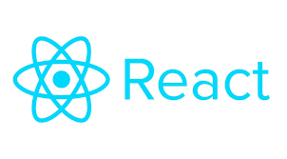
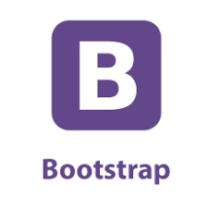

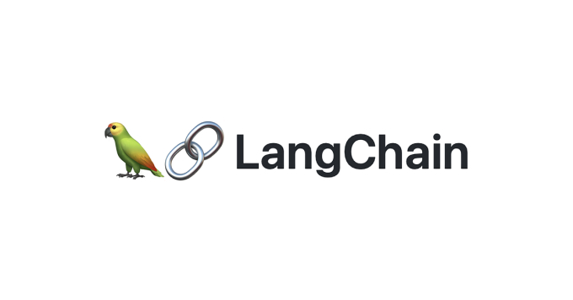


TECHNOLOGIES USED
FAISS Vector Database

Slide 5
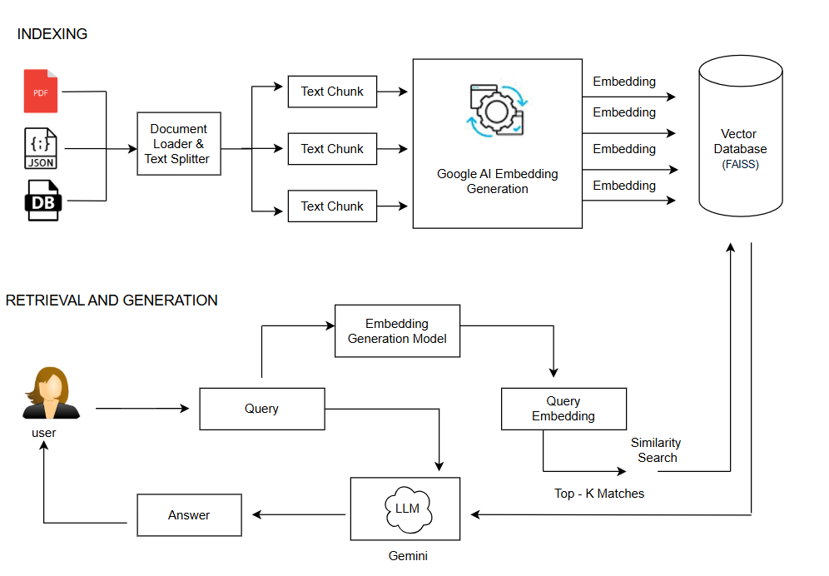
SYSTEM ARCHITECTURE

Slide 6
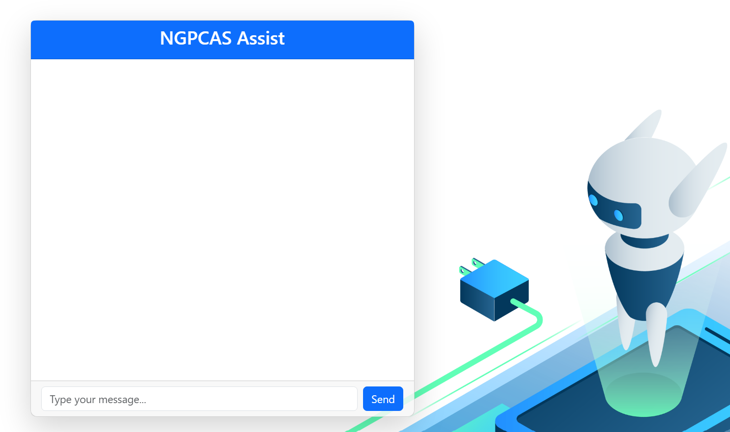
RAG User-Interface

Slide 7
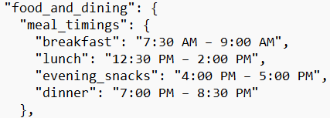
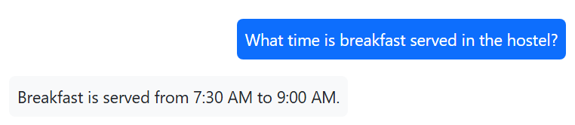
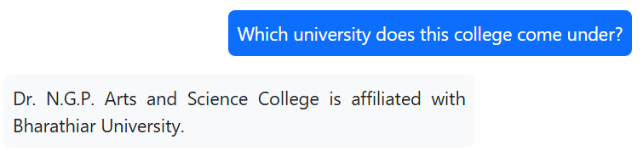
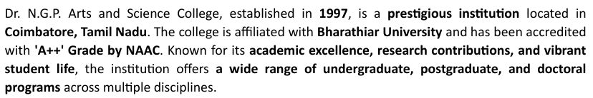
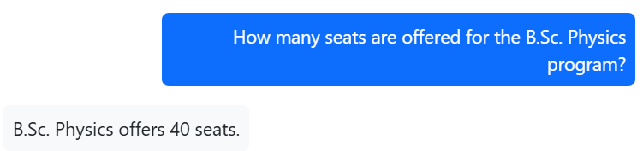
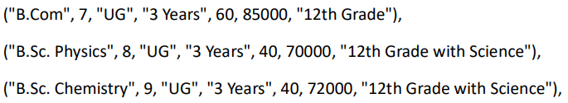
Chatbot Response vs Knowledge Base

Slide 8
Future Improvements
1
Real-Time Data Updates
Sync with live data sources for the latest information.
2
Feedback Loop
Continuously learn from user feedback to improve.
Multi-Language Support
3
Handle multiple languages for wider accessibility.
4
Multimodal Input
Support text, voice, image, and video inputs.

Slide 9
Team and Contributions
Dhanya K.R - Backend Developer
Gobika G – Data Specialist
Designed and implemented the RAG Pipeline.
Collected, preprocessed, and organized data.
Venkatesh S - Front-end Developer
Pavithran S – QA Engineer
Designed and developed the user interface.
Tested the RAG system for accurate Q&A.

Slide 10

Q&A and Thank You
We welcome your questions and feedback.
Thank you to our organizers and sponsors.

